Slide 1
Immutable data types Lecture 2 Part 1

Slide 2
Goal of this part
Goal 1: Learn what immutable data types are.
Goal 2: Understand why you would use them.
Why these goals: immutable data makes it possible to write pure functions, enabling you to benefit from the advantages of functional programming.
Notes:
De vraag die we beantwoorden in de introductie.

Slide 3
Reminder: Functional programming
Exercise: What do you remember about functional programming?

Slide 4
What are immutable data types?
An immutable object is an object whose state cannot be modified after it is created
val x: Int = 5 x = 6 // Error x += 1 // Error

Slide 5
How do we use immutable data types?
You may wonder:
How can immutable data types be useful if we cannot change their state?
Let take a look at an example of an immutable map
Scala
Has immutable and mutable collections
scala.collection.immutable (Default)
scala.collection.mutable
val myMap = Map("Bob" -> 27) val myUpdatedMap = myMap + ("Rob" -> 35)

Slide 6
Immutable objects VS immutable references
Important distinction!
An immutable map with a mutable reference
A mutable map with an immutable reference
An immutable map with an immutable reference
var myImmutableMap = Map("Bob" -> 27) myImmutableMap = Map("Rob" -> 35)
val myMutableMap = scala.collection.mutable.Map("Bob" -> 27) myMutableMap += ("Rob" -> 35) myMutableMap -= "Bob"
myMutableMap = scala.collection.mutable.Map("Rob" -> 35) // Error
val myImmutableMap = Map("Bob" -> 27) myImmutableMap += ("Rob" -> 35) // Error myImmutableMap = Map("Rob" -> 35) // Error
Notes:
TO DO docent: Slotjes tekenen op whiteboard

Slide 7
Immutable collections
Exercise: Which data structures do you remember?
Step 1: Don’t use Google / StackOverflow! Write down all data structures you remember.
Step 2: Everyone stand up!
Step 3: First person shares one data structure with the class. If you had it on your list, keep standing. If you didn’t, sit down.
Step 4: Repeat until one person is left standing.
Notes:
From ADS or previous projects.

Slide 8
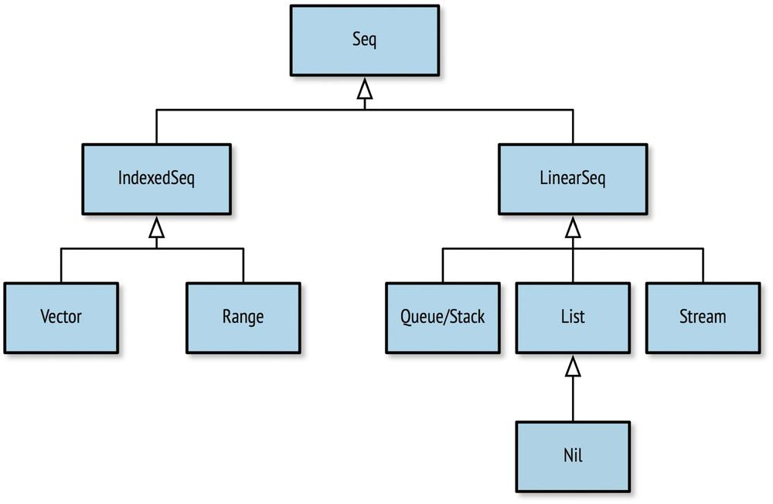
Immutable collections
Sequences in Scala: Collections where elements have an ordering
Notes:
A vector: Can be considered the Immutable equivalent of an array (Actually the immutable equivalent of an ArrayBuffer). Fast random access.
Range: Represents an integer sequence like 0, 1, 2, 3, 4, 5. Does not store the values, only the start, end and increment.
Stack, queue and priority queue are standard data structures.

Slide 9
Immutable collections
A vector:
Can be considered the Immutable equivalent of an array
(Actually, the immutable equivalent of an ArrayBuffer).
Fast random access
Range:
Represents an integer sequence like 0, 1, 2, 3, 4, 5
Does not store the values, only the start, end and increment.
Stack, queue and priority queue are standard data structures

Slide 10
Immutable collections: List
List
A list is a recursive collection. A list is either:
Nil. Represents an empty list (or think of it as the end of a list)
An element followed by a List. The element is also referred to as the head and the remaining List as the tail.
You could see a List as the immutable version of a LinkedList
val myList = List(8, 4, 2) myList.head // 8 myList.tail // List(4, 2) myList.tail.head // 4 myList.tail.tail // List(2) myList.tail.tail.tail == Nil // True myList.tail.tail.tail.tail // Error

Slide 11
Immutable collections: List
Lists can be constructed by defining the head and the tail
:: is called the ‘cons operator’ (now you can Google it…)
val myEmptyList = Nil myEmptyList // List() // The operator :: makes a new List from a head and a tail val myNewList = 2 :: myEmptyList // 2 is the head, the empty list is the tail myNewList // List(2) val myNewerList = 4 :: myNewList // 4 is the head, List(2) is the tail myNewerList // List(4, 2) val myNewestList = 8 :: myNewerList // now 8 is the head, List(4, 2) is the tail myNewestList // List(8, 4, 2) // :: is right-associative, lists are constructed from the right hand end. 8::4::2::Nil // List(8, 4, 2)

Slide 12
Immutable collections: List
Scala also allows us to initialize a list with List(el1, el2, el3, …)
The head & tail of a list can be deconstructed into separate variables
val myList = List(2,4,6,8)
val head::tail = myList head // 2 tail // List(4,6,8)

Slide 13
Immutable collections: Set
A collection of distinct elements. Elements in a set have no particular order.
In Scala …
the default Set implementation is a HashSet.
every object has a hashCode() methode just as in Java. (GetHashCode() in C#)
Set(4, 2, 0) + 2 == Set(2, 0, 4) // True

Slide 14
Immutable collections: Map
A map consists of pairs of keys and values. The key of a pair has to be unique, otherwise you overwrite the associated value.
val myMap = Map("Bob" -> 27, "Rob" -> 35) myMap("Rob") myMap + ("Bart" -> 23) // Map(Bob -> 27, Rob -> 35, Bart -> 23) myMap + ("Rob" -> 42) // Map(Bob -> 27, Rob -> 42)

Slide 15
Immutable data collection: Tuples
A tuple is a value that contains a fixed number of elements, each with a distinct type.
Tuples are immutable.
Can be handy for returning multiple values from a function
val ingredient = ("Sugar" , 25) // Type: (String, Int) println(ingredient._1) // Sugar println(ingredient._2) // 25 val (name, quantity) = ingredient println(name) // Sugar println(quantity) // 25

Slide 16
Why would we want immutable data types?
If an immutable data object is in a valid state, it will always remain in a valid state
You can safely pass them around without the concern that the state might be altered
There is no need to create a copy of an immutable object
Easier to test
Thread-safe
You can safely share a reference to an immutable data type, even in a multithreaded program
They are inherently thread-safe
Thread-safe: Two or more threads working on a shared resources or object must not override the changes done by the other thread

Slide 17
Race conditions
Thread 1
Counter
Thread 2
Problem with mutable data. Think of the problems with databases and their ACID properties.
Suppose we have two threads, both trying to increment the counter.
Get 0
Get 0
0 + 1 = 1
0 + 1 = 1
Set 1
var counter = 0 def increment() = { counter += 1 }
Set 1
Time
counter == 1 ?!

Slide 18
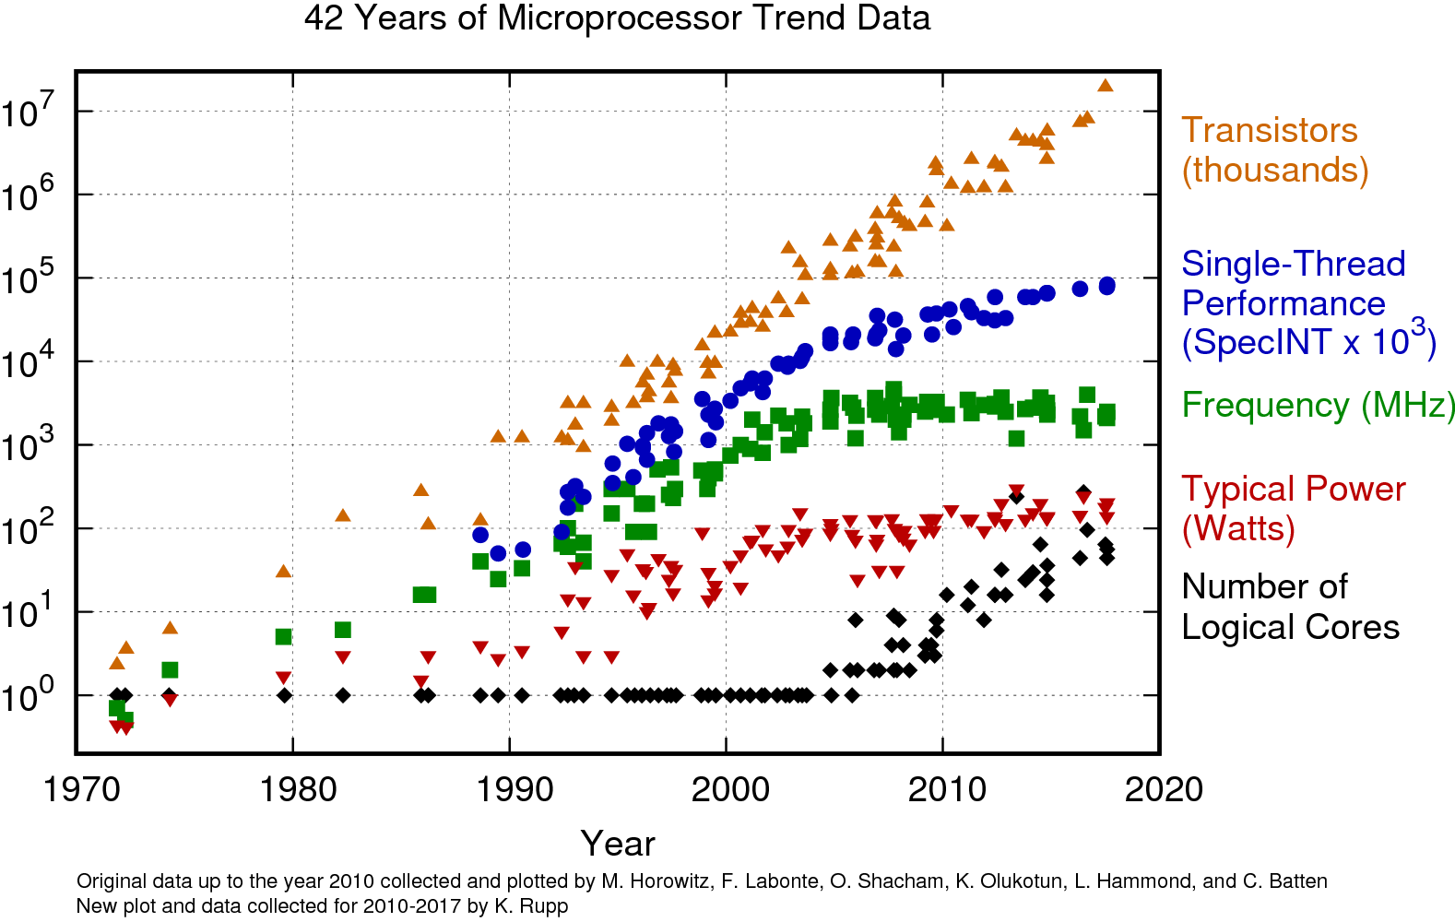
Why do we want multithreaded programs?
Notes:
Moore”s law states “processing power for computer will double every two years” – http://www.mooreslaw.org/
In other words: Moore’s law states that our CPU’s (with 1 logical core) doubles in speed every two years.
This was true for a long time, but Moore’s law has slowed down for some time now and is even starting to fall flat.
However, the cost of 1 logical core does keep falling. So we started to place multiple logical cores in a CPU. (2: Dual core, 4: Quad core, 8: Octo core, etc.)
If we want to keep scaling the performance of our programs, our programs will need to use multiple logical cores (-> multithreading)

Slide 19
Achieved goal of this part?
Goal 1: Learn what immutable data types are.
Goal 2: Understand why you would use them.
Why these goals: immutable data makes it possible to write pure functions, enabling you to benefit from the advantages of functional programming.
Notes:
De vraag die we beantwoorden in de introductie.

